Slide 1
Diabetes Prediction
Using Machine Learning
Project By:
Ramees Noushad
Pooja Konduskar
Priya Jadhav
Sourabh Kumar
Anoop Alex

Slide 2
Table of Contents
01
Introduction
02
Problem Statement
Importance of diabetes prediction and intro to our project
Problem we are tried to solve
03
Dataset
04
Exploratory Data Analysis
Overview of our diabetes data
Process of transforming raw data into meaningful insights
05
Models Training and Evaluation
06
Model Selection
Process of training the models to predict
Comparison of different models
07
Conclusion
08
Reference
Summarize the key findings
Sources of information

Slide 3
01
Introduction

Slide 4
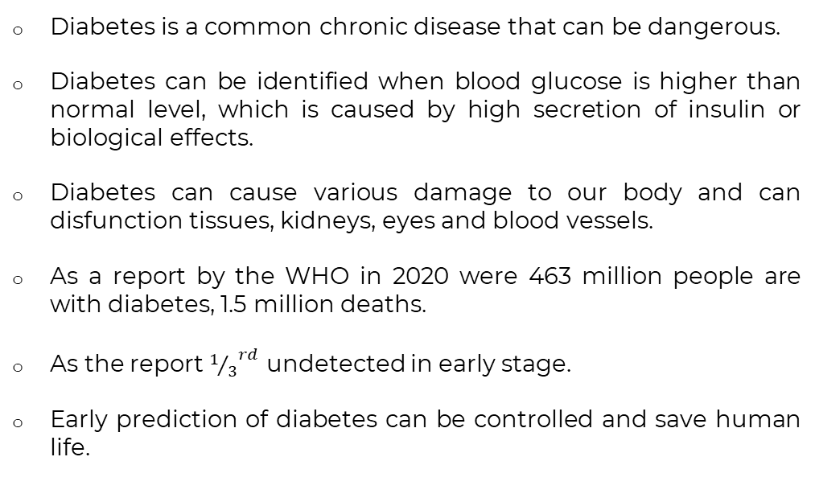
Introduction
Diabetes is a common chronic disease that can be dangerous.
Diabetes can be identified when blood glucose is higher than normal level, which is caused by high secretion of insulin or biological effects.
Diabetes can cause various damage to our body and can disfunction tissues, kidneys, eyes and blood vessels.
As a report by the WHO in 2020 were 463 million people are with diabetes, 1.5 million deaths.
As the report ${1/3}^{rd}$ undetected in early stage.
Early prediction of diabetes can be controlled and save human life.

Slide 5
Problem Statement
02

Slide 6
Problem Statement
Early detection and prediction of diabetes are crucial for effective management and treatment, as it allows for timely interventions, lifestyle modifications, and personalized care plans.
The limitations of current approaches to diabetes prediction, such as subjectivity, reliance on manual assessment, and potential for human errors.
We need to create a more accurate, automated, and data-driven prediction methods.
The goal of this project is to find which machine learning model capable of accurately predicting the occurrence of diabetes in patients, based on relevant clinical and demographic features.
This project addresses the need for a comprehensive and interpretable prediction model that can be readily integrated into healthcare systems, facilitating the proactive management of diabetes and reducing its associated complications.
By leveraging machine learning and predictive analytics, our project seeks to contribute to the growing field of healthcare innovation and personalized medicine, paving the way for data-driven approaches in diabetes care and management.

Slide 7
03
Dataset

Slide 8
Dataset
Our dataset was obtained from Kaggle, a popular online community for data science and machine learning.
The dataset consists of 1,00,000 rows and 9 columns, making it a substantial dataset for a diabetes prediction.
Features included:
Gender
Age
Hypertension
Heart Disease
Smoking History
BMI - (Body Mass Index)
HbA1c Level -
(Glycated Haemoglobin)
Blood Glucose Level
Diabetes

Slide 9
Exploratory Data Analysis
04

Slide 10

Exploratory Data Analysis
Examined the dataset carefully and removed some data that had missing values and duplicates. This step ensured that we were working with reliable and accurate data.
After cleaning our dataset now consists of 961464 rows and 8 columns. This means we have retained a significant amount of data for our analysis.
By performing these cleaning procedures, we ensured that our dataset meets high standards of data quality and data integrity. This give us confidence that our subsequent analysis and modelling will be based on reliable and accurate data.

Slide 11
Statistical Measures
 | gender | age | hypertension | heart_disease | bmi | HbA1c_level | blood_glucose_level | diabetes
count | 96146 | 96146 | 96146 | 96146 | 96146 | 96146 | 96146 | 96146
unique | 3 | NaN | NaN | NaN | NaN | NaN | NaN | NaN
top | Female | NaN | NaN | NaN | NaN | NaN | NaN | NaN
freq | 56161 | NaN | NaN | NaN | NaN | NaN | NaN | NaN
mean | NaN | 41.783756 | 0.077601 | 0.040803 | 27.321461 | 5.532609 | 138.218231 | 0.08822
std | NaN | 22.482208 | 0.267544 | 0.197833 | 6.767716 | 1.073232 | 40.909771 | 0.283616
min | NaN | 0 | 0 | 0 | 10.01 | 3.5 | 80 | 0
25% | NaN | 24 | 0 | 0 | 23.4 | 4.8 | 100 | 0
50% | NaN | 43 | 0 | 0 | 27.32 | 5.8 | 140 | 0
75% | NaN | 59 | 0 | 0 | 29.86 | 6.2 | 159 | 0
max | NaN | 80 | 1 | 1 | 95.69 | 9 | 300 | 1

Slide 12
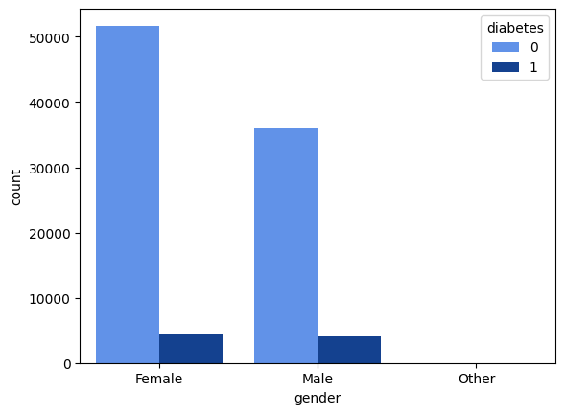
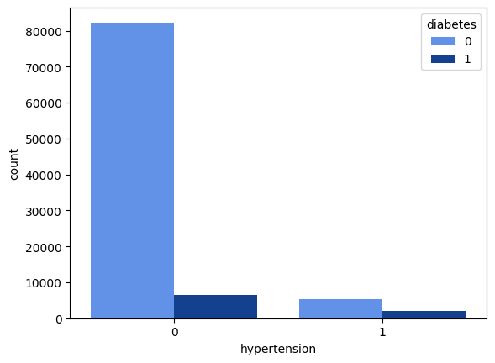
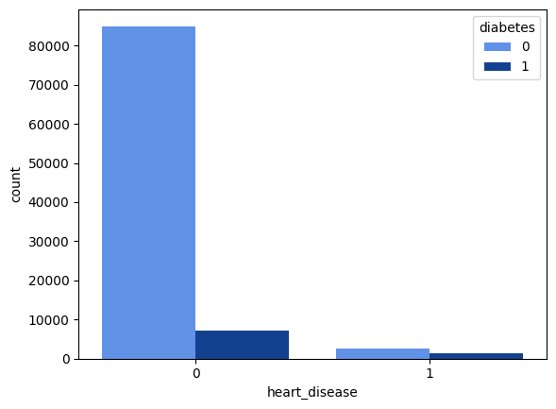
Distribution of Diabetes with Categorical Variables

Slide 13
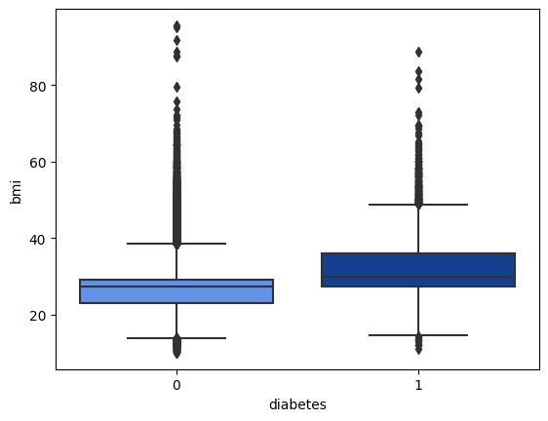
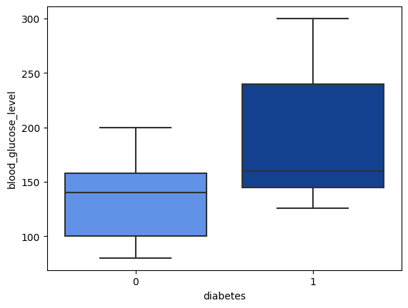
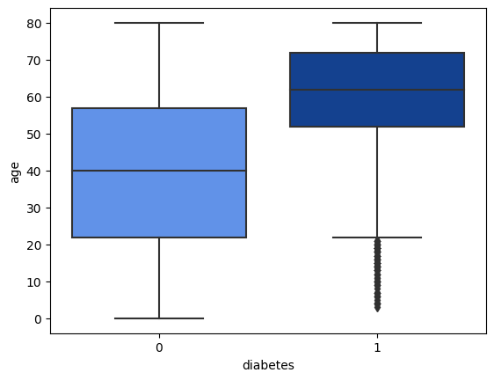
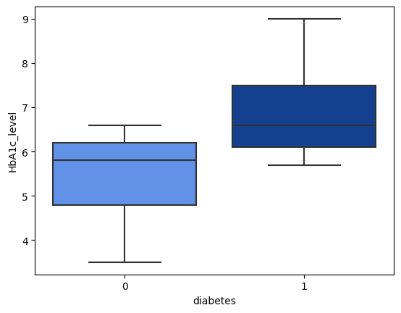
Distribution of Diabetes with Continuous Variables

Slide 14
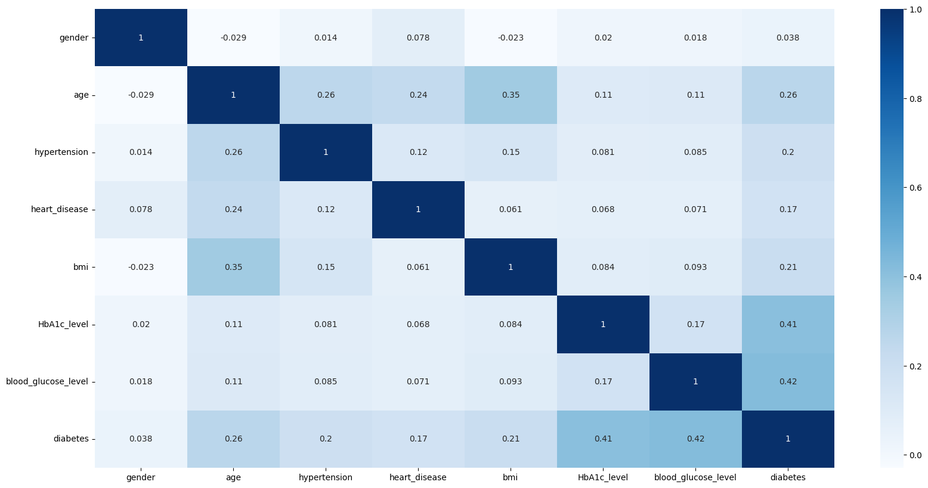
Correlation Plot

Slide 15
05
Model Training and Evaluation

Slide 16
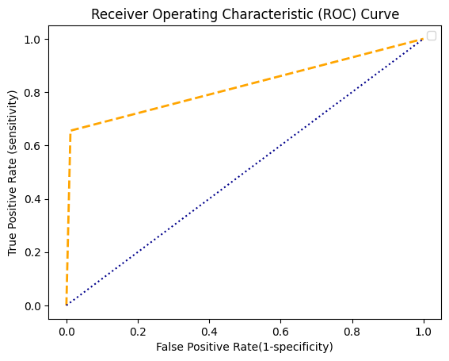
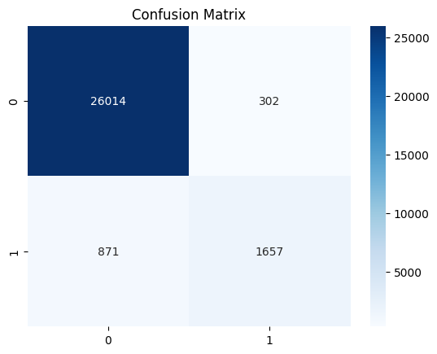
Logistic Regression
True Neg
False Pos
Predicted
False Neg
True Pos
Actual
Accuracy : 95.93 % Sensitivity : 96.76 %
Specificity : 84.58 % Precision : 98.85 %
Recall : 96.75 % F-score : 97.79 %

Slide 17
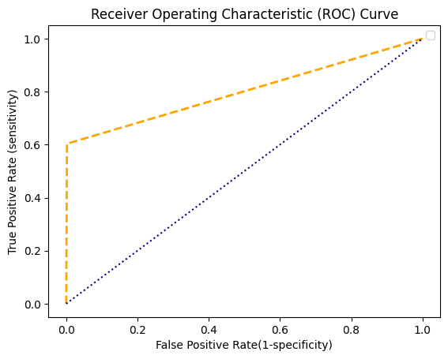
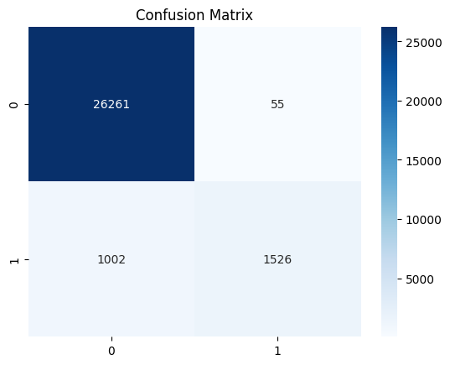
Support Vector Machine (SVM)
True Neg
False Pos
Design
Synthesize
Predicted
False Neg
True Pos
Actual
Accuracy : 96.33 % Sensitivity : 96.32 %
Specificity : 96.52 % Precision : 99.79 %
Recall : 96.32 % F-score : 98.02 %

Slide 18
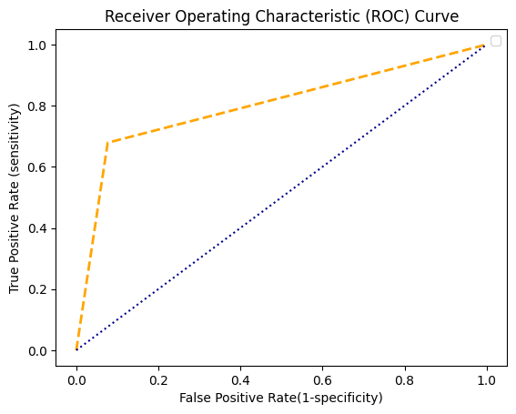
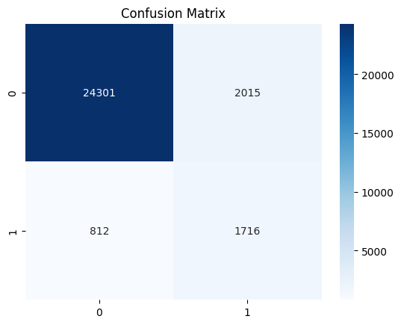
Naive-Bayes
True Neg
False Pos
Predicted
False Neg
True Pos
Actual
Accuracy : 90.19 % Sensitivity : 96.76 %
Specificity : 45.99 % Precision : 92.34 %
Recall : 96.76 % F-score : 94.50 %

Slide 19
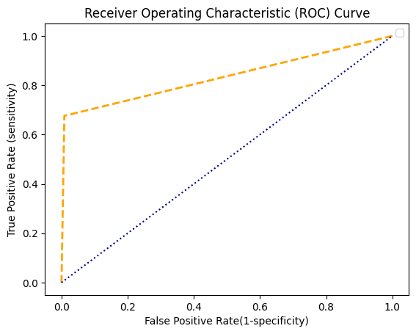
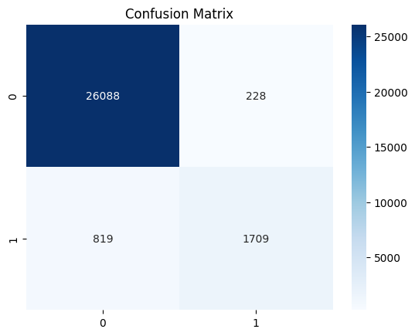
K-Nearest Neighbour
True Neg
False Pos
Predicted
False Neg
True Pos
Actual
Accuracy : 96.37 % Sensitivity : 96.95 %
Specificity : 88.22 % Precision : 99.13 %
Recall : 96.95 % F-score : 98.02 %

Slide 20
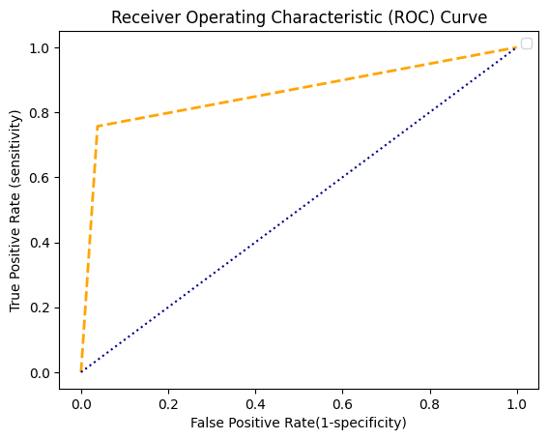

Decision Tree
True Neg
False Pos
Predicted
False Neg
True Pos
Actual
Accuracy : 94.48 % Sensitivity : 97.63 %
Specificity : 66.19 % Precision : 96.28 %
Recall : 97.63 % F-score : 96.95 %

Slide 21

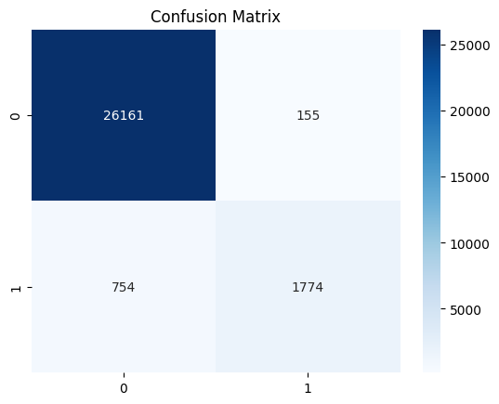
Random Forest
True Neg
False Pos
Predicted
False Neg
True Pos
Actual
Accuracy : 96.90 % Sensitivity : 97.23 %
Specificity : 92.24 % Precision : 99.43 %
Recall : 97.23 % F-score : 98.32 %

Slide 22
Model Selection
06

Slide 23
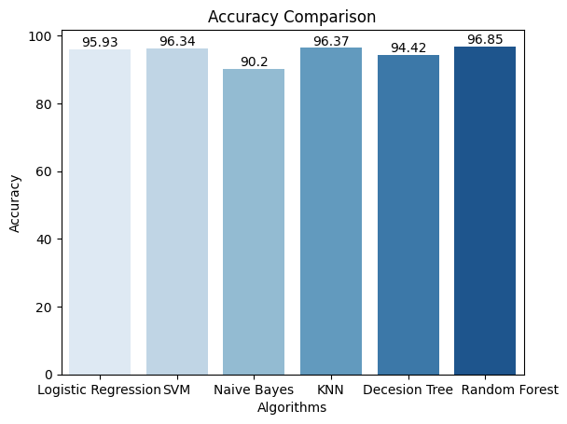

Slide 24
07
Conclusion

Slide 25
Conclusion
The random forest algorithm demonstrated the highest accuracy among the models tested, indicating its potential as a powerful tool for diabetes prediction In our project.
Accuracy is a crucial metric in predictive modeling, as it directly impacts the effectiveness of healthcare interventions and patient outcomes. The high accuracy achieved by the random forest algorithm provides confidence in its ability to make reliable predictions.
Accurate diabetes prediction has significant real-world implications. It enable early interventions, personalized treatment plans, and improved disease management, leading to better healthcare outcomes and quality of life for individuals at risk of or already diagnosed with diabetes.
Accurate diabetes prediction using random forest model has the potential to make a significant impact on healthcare. It can empower healthcare professionals to implement proactive interventions, improve patient care, and contribute to advancements in diabetes management and prevention.

Slide 26
References
08

Slide 27
References
Data Set - Diabetes prediction dataset | Kaggle

Slide 28
Thank You

